Slide 1

Housing Best Practices Forum
Welcome!

Slide 2

Housing Best Practices Forum: Minnesota Supplemental Aid
Notes:
HEIDI

Slide 3
Logistics (boring yet necessary)
Audio can be done over your computer OR conference call line
Conference call number:
888-742-5095
Meeting ID: 282-843-9565
Conference call lines will be muted. You can ask questions through the WebEx chat feature.
Follow up evaluation
Notes:
HEIDI

Slide 4
Format of Forums
Every other month (evens), third Monday, 1:30-3:30
Taped presentation and materials available post-session on mn.HB101.org (partners tab)
Steering Committee to oversee agenda and topics
Notes:
HEIDI

Slide 5
Minnesota Supplemental Aid Housing Assistance
John Petroskas
MN DHS
June 19, 2017

Slide 6
Supplemental Security Income (SSI)
Federal cash assistance benefit for people who:
Are aged (over 65), blind, or disabled, and
Have limited income and resources
2017 SSI “Federal Benefit Rate” or FBR:
$735/month for an eligible individual
$1,103/month for an eligible couple
Some people get both SSI and SSDI (aka RSDI)

Slide 7
MINNESOTA SUPPLEMENTAL AID (MSA)
Monthly cash supplement to SSI payment
About 31,000 people received MSA monthly in 2016
Over 80,000 Minnesotans aged 18-65 receive SSI
MSA spending in FY2015 was $37 million
Funded under a ‘maintenance of effort’ agreement with SSA

Slide 8
MSA Eligibility Criteria CM 13.09
To be eligible for MSA a person must be:
Over age 18 (unless blind), and
Receiving SSI in any amount, OR
Would be receiving SSI except for excess income AND age 65+, blind, or disabled.

Slide 9
MSA Assistance standards CM 20.21
Person living alone (unless eligible for a waiver, GRH placement*, or Housing Assistance) | $796.00
Person living with others | $582.66
Married couple living alone | $1,194.00
Married couple living with others * GRH recipients are ineligible for MSA | $799.34

Slide 10
Typical MSA Monthly Benefit Amounts
Individual ($735 SSI) $81
Individual ($490 SSI) $112.66
Couple living alone $111
Facility resident $67
($30 SSI payment, living arrangement D)
Additional $ for special needs

Slide 11
MSA Special Needs Programs
Special Diets CM 23.12
Guardian/Conservator Fees CM 23.15
Representative Payee Fees CM 23.21
Home Repairs CM 23.06
Home Furnishings & Appliances CM 23.09
Housing Assistance CM 23.24

Slide 12
MSA Housing Assistance Eligibility
Person must meet ALL of these conditions:
Eligible for MSA, and
Monthly housing costs exceed 40% of gross monthly income, and
Apply for rental assistance, and
Under age 65 and….

Slide 13
MSA Housing Assistance Eligibility
Meet ONE of the following criteria:
Relocating to the community from a hospital, nursing facility, regional treatment center, ICF-DD, or IRTS; or
Eligible for MA personal care assistance (PCA) services; or
Waiver recipient living in their own home or apartment.

Slide 14
MSA Housing Assistance - example
$735 SSI benefit $81 MSA benefit +$194 MSA Housing Assistance
$275 Total MSA benefit $1,010 Total monthly income
This is a 38% increase in income over SSI alone!
Clients can also receive some SNAP benefits

Slide 15
FUTURE CHANGES to MSA Housing Assistance
The current MSA Housing Assistance benefit is $194/month. This is equal to the SNAP single adult monthly allotment.
Effective 7/1/2020, this will increase to one-half the monthly SSI federal benefit rate (presently $735; MSA-HA would increase to $367.50 if today’s FBR was used).
Also effective 7/1/2020, Housing Supports (formerly GRH) settings will be added to the list of places from which a person can relocate to the community.

Slide 16
APPLYING FOR MSA HoUSING ASSISTANCE
Apply using the Combined Application Form (DHS-5223). Check the “cash programs” box, then sign and date page 1.
Document shelter expenses using a lease, rental agreement or Shelter Verification Form (DHS-2952). Specify any utilities the client must pay.
Use the Verification of Application for Rental Assistance (DHS-6351).
MSA Housing Assistance may be unfamiliar to some workers. Attach a note to the CAF asking to be screened for it. Explain why the client may be eligible.
An interview is required, but it does not need to be face-to-face. Request a phone interview if that would be more convenient for the client.

Slide 17
MSA Living Arrangements
Often, people are ineligible for MSA because they live with others.
Our current policy doesn’t distinguish between people who live with family, don’t pay rent, share meals, and those who live with others simply out of economic necessity.
Counties make their own living arrangement determinations – they don’t just follow the SSA-determined Federal Living Arrangement.

Slide 18
MSA Assistance Standards – CM 20.21
The term “living with others” applies to anybody who is living with others, regardless of financial arrangements or relationship. MSA clients are considered to be in a "shared household” living situation if they live with another person(s) and they do not have separate, self-contained living quarters with a separate entrance. Self-contained living quarters consists of the client’s own bedroom, living room and kitchen. … If a client lives with others, the living with others (shared) MSA standard will be applied unless he/she is eligible for MA home and community based waiver, meets the county plan requirements for GRH, or is eligible for the MSA Housing Assistance (shelter need) special need. …

Slide 19
Proposed new POLICY:
Apply the living alone assistance standard if a person lives in their own residence without others. If a person lives with others, apply the living with others assistance standard UNLESS they: - are eligible for an HCBS waiver; - meet county plan requirements for GRH; - are eligible for MSA Housing Assistance; or - constitute a separate household from others who reside at that address. A separate household exists when a person (1) pays market-based rent and is subject to an individual lease or rental agreement; (2) purchases, prepares and eats meals separately from others in the household; and (3) has exclusive use of part of the residence (such as a bedroom). If the client meets ANY of these criteria, apply the living alone assistance standard.

Slide 20
MN Department of Human Services
John Petroskas
General Assistance & Minnesota Supplemental Aid Policy
651-431-5644
John.Petroskas@state.mn.us

Slide 21
Case Examples
1

Slide 22
Types of Case Examples
SSI + MSA + MSA Housing Assistance – Live alone
SSI + MSA + MSA Housing Assistance – Roommate
SSI + MSA+ MSA Housing Assistance plus work 10 hrs/week – Live alone
SSI + MSA+ MSA Housing Assistance plus work 10 hrs/week – Roommate
SSI + MSA + MSA Housing Assistance plus work 20 hrs/week – Iive alone
SSI + MSA + MSA Housing Assistance plus work 20 hrs/week – Roommate
RSDI - How to figure if eligible for MSA Housing Assistance
Not on SSI due to work, but qualifies as disabled

Slide 23
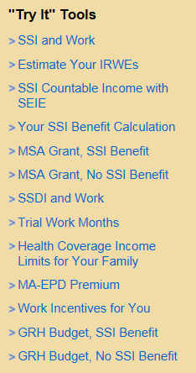
“Try It” Tools on DB101.org
Use Try-It Tools on DB101.org
Go to Partners Tab
The 3 tools that will give you a good estimate

Slide 24
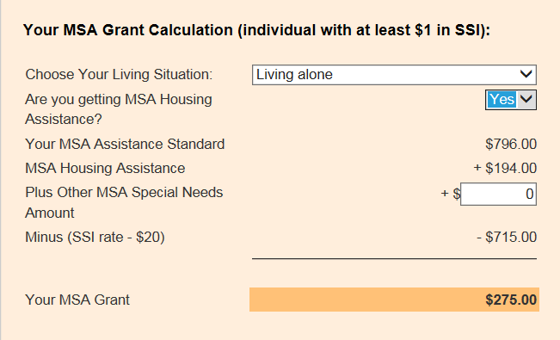
SSI + MSA + MSA Housing Assistance No Roommate
John gets SSI of $735. He meets eligibility criteria for MSA Housing Assistance. He pays $900 in rent. His MSA + MSA Housing Assistance will be $275 per month
Choose Living alone
Choose Yes
You would use this if
John had special diet
or rep payee
John’s total MSA + MSA
Housing Assistance

Slide 25
Budget: SSI + MSA + MSA Housing Assistance No Roommate
John’s income is $1010
John’s rent is $900
He only has $110 left over
He will get $71 in SNAP benefits if he doesn’t pay any utilities
He will get $113 in SNAP benefits if he pays electricity, and doesn’t have air conditioning
If he pays either heat or electricity with air conditioning, he will get $194 in SNAP

Slide 26
John gets a roommate – can he still get MSA?
John decides to see what would happen if he gets a roommate. They would need a 2 BR Apartment, so they would pay $1200 per month in rent. John’s share is $600 per month, which is still over 40% of his income. He is still eligible for MSA + MSA Housing Assistance of $275.

Slide 27
Budget: SSI + MSA + MSA Housing Assistance - Roommate
John’s income (SSI, MSA + MSA Housing Assistance) is $1010
His share of rent is $600
He has $410 left over
He will get $16 in SNAP benefits if he doesn’t pay any utilities
He will get $23 in SNAP benefits if he pays electricity but doesn’t have air conditioning
He will get $140 in SNAP benefits if he pays heat or electricity with air conditioning

Slide 28
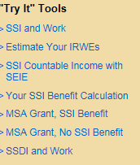
SSI + MSA + plus MSA Housing Assistance and working 10 hours per week. No roommate.
John decides to work 10 hours per week for $10 per hour and not have a roommate. He is paying $900 per month in rent. His SSI will change due to his earnings.
The first step is to open up “Your SSI Calculation Quick Tool” to determine how his earnings will affect his SSI.

Slide 29
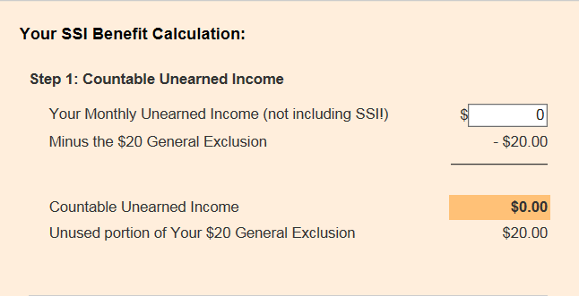
Use the SSI Benefit Calculation “Try It” Tool
Do NOT enter the SSI amount here. Only OTHER unearned income.

Slide 30
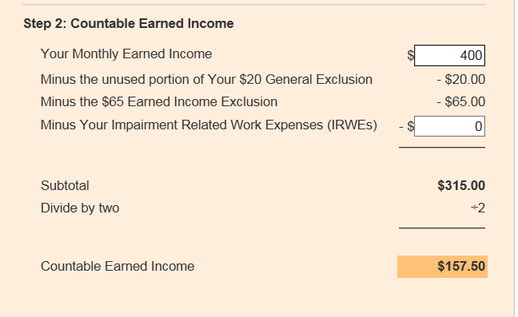
Use the SSI Benefit Calculation “Try It” Tool
John will earn $10 per hour, 10 hours per week. I am keeping the formula simple, and stating that he will make $400 per month.

Slide 31
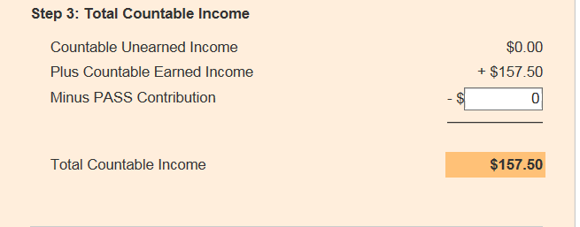
Use the SSI Benefit Calculation “Try It” Tool
John does not have a pass plan

Slide 32
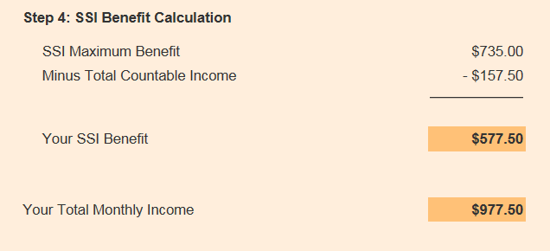
Use the SSI Benefit Calculation “Try It” Tool

Slide 33
SSI + MSA + plus MSA Housing Assistance and working 10 hours per week. No roommate.
Because John is receiving at least $1 in SSI, and because his rent is still over 40% of his income, he is eligible for the $275 in MSA and MSA Housing Assistance.

Slide 34
Budget: SSI + MSA + plus MSA Housing Assistance and working 10 hours per week - No roommate
Income (SSI, work, MSA + MSA Housing Assistance) = $1252.50
Rent = $900
He has $352.50 left over
He will get $16 in SNAP benefits if he doesn’t pay utilities
He will get $84 in SNAP benefits if he pays electricity, but doesn’t have air conditioning
He will get $194 in SNAP benefits, if he pays heat or electricity with air conditioning

Slide 35
SSI, Work 10 Hours, MSA + MSA Housing Assistance, and Get a Roommate
John decides to look at what his budget would be if he did decide to get a roommate
His Income (SSI, Work 10 hours, MSA + MSA Housing Assistance) = $1252.50
He is still eligible for MSA + MSA Housing Assistance because his rent is more than 40% of his income

Slide 36
Budget: SSI, Work 10 Hours, MSA + MSA Housing Assistance, and Get a Roommate
John’s Income (SSI, Work 10 hours, MSA + MSA Housing Assistance) = $1252.50
John’s share of rent on a 2 BR $1200 apartment = $600
John has $652.50 left over
John will get $16 in Food Support if he doesn’t pay any utilities
John will get $16 in Food Support if he pays electricity, but doesn’t have air conditioning
John will get $111 in Food Support if he pays heat or electric and has air conditioning

Slide 37
SSI + MSA + plus MSA Housing Assistance and working 20 hours per week - No roommate
John wants to explore another option. He wants to see what will happen if he works 20 hours per week and doesn’t have a roommate.
The first step is to open up “Your SSI Calculation Quick Tool” to determine how his earnings will affect his SSI.

Slide 38
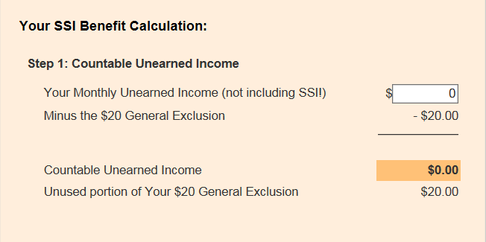
SSI, work 20 hours per week, and no roommate
Open the calculate your SSI “Try-it Tool”
Do NOT enter the SSI amount here. Only enter Other unearned income

Slide 39
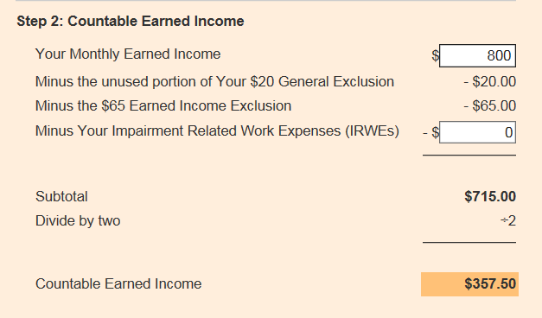
SSI, work 20 hours per week, and no roommate
John works 20 hours per week for $10 per hour.

Slide 40
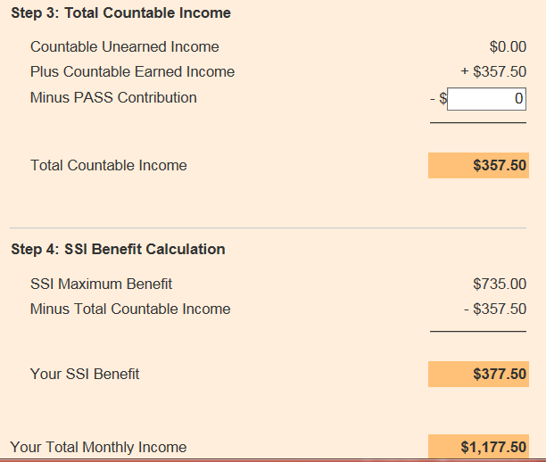
SSI, work 20 hours per week, and no roommate
John is still eligible for SSI!

Slide 41
SSI, work 20 hours per week, and no roommate
John is still eligible for at least $1 of SSI Benefits, and his rent of $900 is still over 40% of his total income of $1177.50, so he is eligible for $275 in MSA and MSA Housing Assistance.

Slide 42
Budget: SSI + MSA + plus MSA Housing Assistance and working 20 hours per week - No roommate
Income (SSI, work, MSA + MSA Housing Assistance)= $1452.50
Rent is $900
John has $552.50 left over
John will get $16 in SNAP benefits if he doesn’t pay any utilities
John will get 16 in SNAP benefits if he pays electricity but doesn’t have air conditioning
John will get $46 in SNAP benefits if he pays heat or electricity with air conditioning.

Slide 43
SSI + MSA + plus MSA Housing Assistance and working 20 hours per week - Roommate
Now John wants to see what his budget would look like if he works 20 hours per week and gets a roommate
Because his rent will still be over 40% of his income, he will still be eligible for MSA + MSA Housing Assistance

Slide 44
Budget: SSI + MSA + plus MSA Housing Assistance and working 20 hours per week - Roommate
Income (SSI, work, MSA+MSA Housing Assistance) = $1452.50
John’s share of a 2 BR, $1200 apartment is $600 (still more than 40% of his income
John has $852.50 left over
He will be eligible for $16 in SNAP benefits, regardless of whether he pays utilities

Slide 45
SSDI and MSA + MSA Housing Assistance
Jane has $815 in SSDI, because she worked long enough to earn SS credits before she became disabled. To see if she qualifies for MSA + MSA Housing Assistance, use the MSA Grant-No SSI “Try-it” Tool.

Slide 46
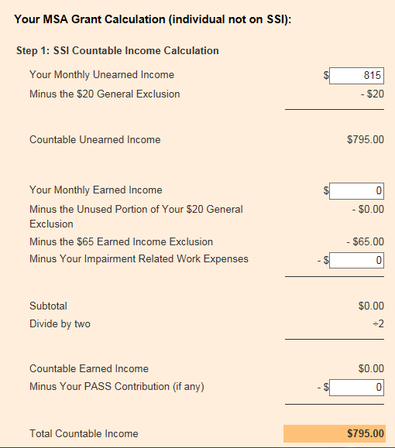
MSA Grant No SSI Try It Tool

Slide 47
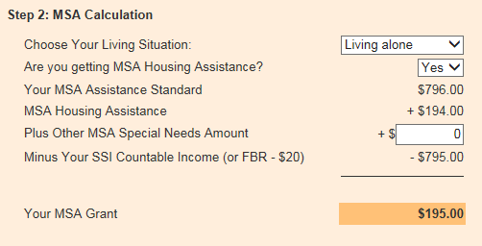
MSA Grant No SSI Try It Tool
Because Jane’s MSA Grant calculates to be $195, it means that she is eligible for MSA of $1, since MSA Housing Assistance is $194.
People with incomes over $815 are not eligible for MSA + MSA Housing Assistance

Slide 48
Budget: SSDI and MSA + MSA Housing Assistance – No Roommate
Jane’s income is $1010 ($815 SSDI + $1 MSA + $194 in MSA Housing Assistance)
Jane decides to live alone. Her rent is $900
Jane has $110 left over
Jane would get for $80 in SNAP benefits if she pays no utilities
Jane would get for $122 in SNAP benefits if she pays electricity and doesn’t have air conditioning
Jane would get $194 in SNAP benefits if she pays heat or electricity and has air conditioning

Slide 49
Budget: SSDI and MSA + MSA Housing Assistance –Roommate
Jane’s income is $1010 ($815 SSDI + $1 MSA + $194 in MSA Housing Assistance)
Jane decides to get a roommate. Her rent is $600
Jane has $410 left over
Jane would get for $16 in SNAP benefits if she pays no utilities
Jane would get for $32 in SNAP benefits if she pays electricity and doesn’t have air conditioning
Jane would get $149 in SNAP benefits if she pays heat or electricity and has air conditioning

Slide 50
Would be eligible for SSI, but earns too much
Joe is certified disabled, and has been approved for Social Security, but he is employed and earns $10 per hour for 40 hours per week, for a total monthly income of $1600. He pays $900 for rent, so he is paying more than 40% of his income. Let’s see if he is eligible for MSA+MSA Housing Assistance.
Try the “MSA Grant, No SSI Benefit Try-It Tool”

Slide 51
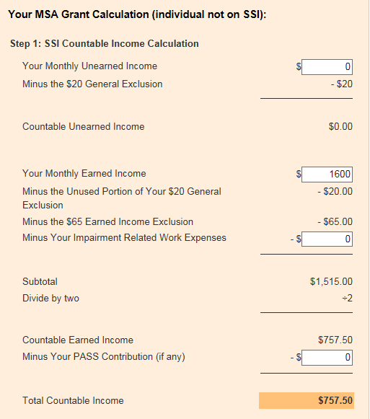
MSA Grant No SSI Try It Tool

Slide 52
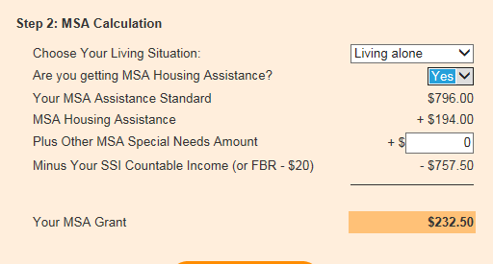
MSA Grant No SSI Try It Tool
Remember to click Living Alone and Yes

Slide 53
Budget: Would be eligible for SSI, but earns too much
Joe’s Budget
Joe’s income (work + MSA + MSA Housing Assistance) = $1832.50
Joe’s rent is $900
Joe has $932.50 left over
Joe will get $16 in SNAP benefits, regardless of whether or not he pays utilities

Slide 54

Use the Disability Linkage Line
If you have questions about a specific situation, you call use the Live Chat Feature on DB101.org
or call the Disability Linkage Line at 1-866-333-2466

Slide 55
Program and policy updates
Permanent Supportive Housing Evidence-Based Practice Stakeholder Group will meet Monday, July 17 from 1:30-2:30
Next topic: Peers in PSH setting
Contact Jen McNertney at jennifer.mcnertney@state.mn.us for more information
Crisis Housing Fund: Short-term housing assistance to people with serious mental illness whose income is being used to pay for inpatient or residential psychiatric or substance use disorder treatment that is expected to last 90 days or less. This program may help pay for rent, mortgage, or utility expenses. Learn more about the Crisis Housing Fund at the Minnesota Housing Partnership website.

Slide 56
Legislative updates
Changing name of Group Residential Housing to Housing Support (July 2017)
Minnesota Supplemental Aid (MSA) Housing Assistance expansion and increase (July 2020)
Authorization to get federal approval for two new Medicaid benefits: 1) Housing Transition Services, and 2) Housing Tenancy Supports (estimated July 2019, but could be sooner)
Competitive grants for counties/tribes to fund (could be subcontract) one or more of the following ($2.8M in FY18-19, $4.1M in FY20-21)(RFP will be issued this year, more to come):
Funding for new website/app to show real-time housing openings ($150K, beginning 2017) (RFP will be issued this year, more to come)
Notes:
Some 2017 Legislative Updates:
Changing name of Group Residential Housing to Housing Support (July 2017)
Housing Support will be the umbrella name – with Room and Board and Supplemental Services.
Clarifies that the benefit isn’t a “place” – but something people receive or provide.
Minnesota Supplemental Aid (MSA) Housing Assistance expansion and increase (July 2020)
A direct income support for people with disabilities with low-income who are moving out of institutions, or off of GRH Housing Support assistance, or receiving waiver or personal care assistance services.
Authorization to get federal approval for two new Medicaid benefits: 1) Housing Transition Services, and 2) Housing Tenancy Supports (estimated July 2019, but could be sooner)
Competitive grants for counties/tribes to fund (could be subcontract) one or more of the following ($2.8M in FY18-19, $4.1M in FY20-21)(RFP will be issued this year, more to come):
Outreach to people who are homeless or in institutions or segregated settings regarding housing options
Housing specialist to be expert on inventory of housing resources for the area (all housing – HUD, MHFA, DHS, public housing, private market, etc.)
Administration/monitoring of GRH Housing Support
Funding for new website/app to show real-time housing openings ($150K, beginning 2017) (RFP will be issued this year, more to come)

Slide 57
Wrap-up
Comments or questions? DHS Housing Options email: dhs.housingoptions@state.mn.us
Presentation and materials available: http://mn.hb101.org/
Complete evaluation
Future sessions

